Slide 1

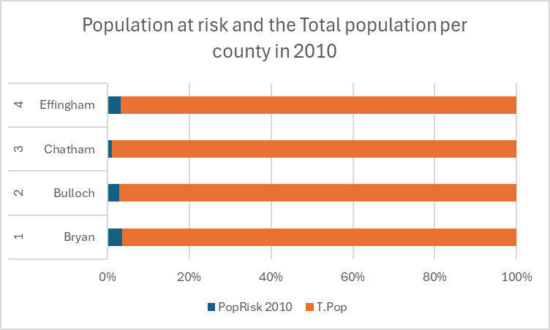
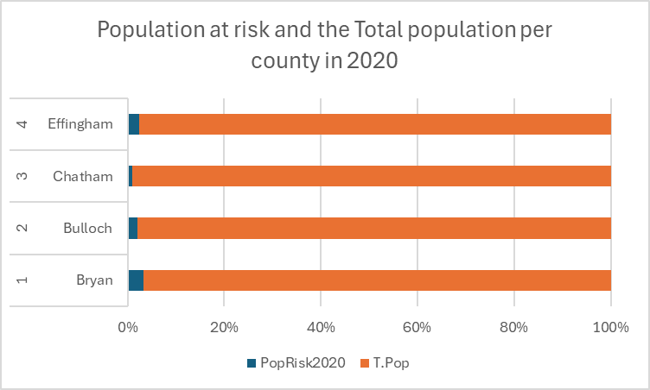
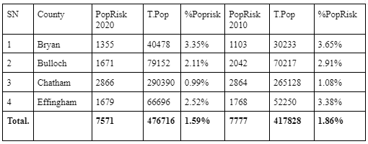
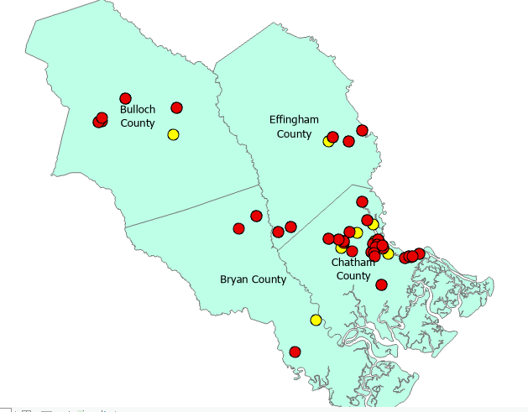
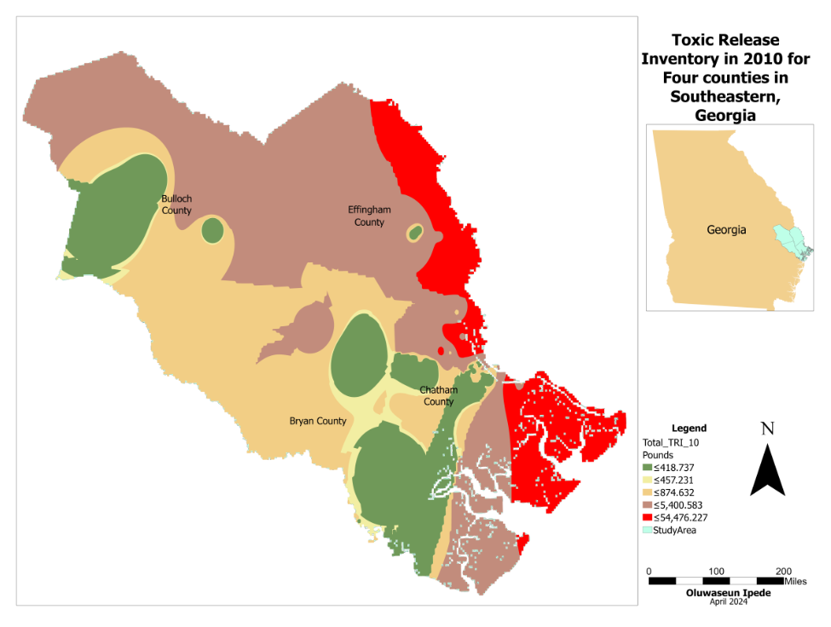
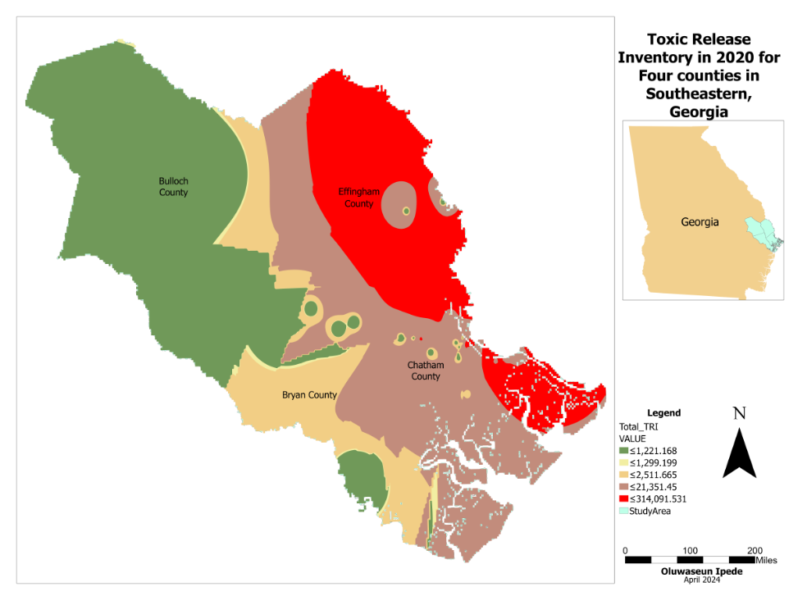
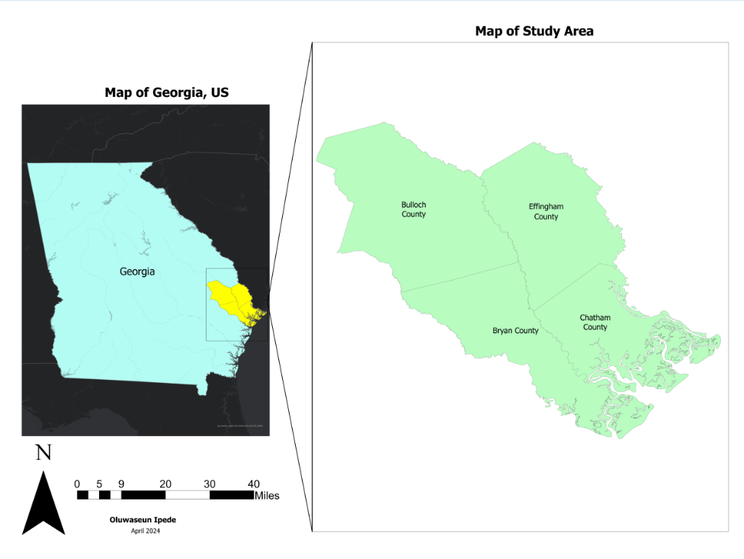
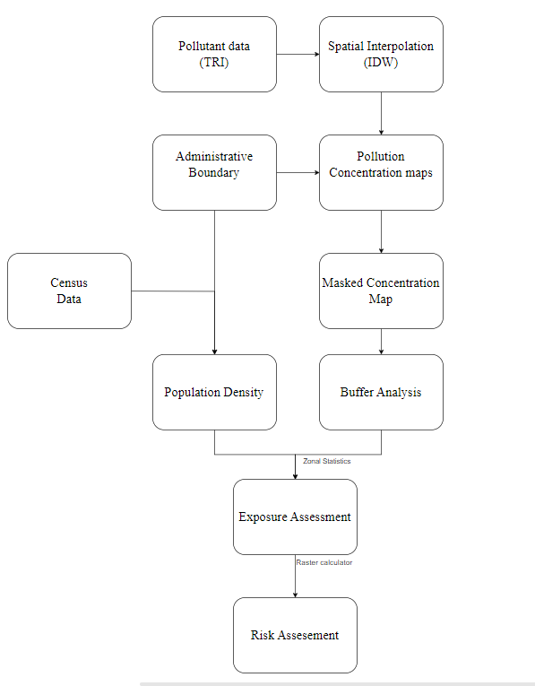
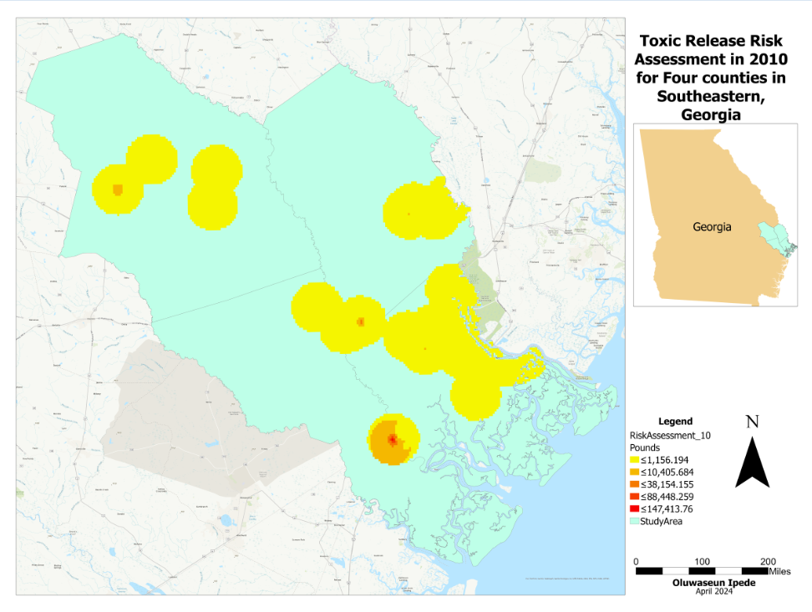
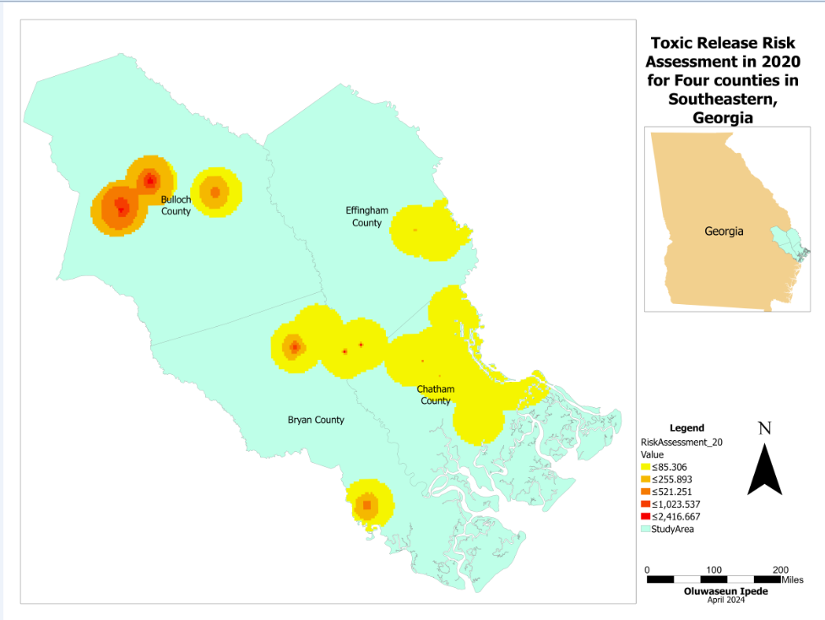
Air Pollution Risk Assessment: A case study of Southeast Georgia, US
Oluwaseun Ipede, Dr Munshi Rahman
School of Earth, Environment, and Sustainability, Georgia Southern University
INTRODUCTION
FIGURES OR TABLES
DISCUSSION
Air pollution poses significant risks to public health and the environment, making its assessment a crucial endeavor. In the United States, the Environmental Protection Agency (EPA) plays a central role in monitoring and regulating air quality standards to safeguard human health and well-being. Almost 9 out of 10 people who live in urban areas worldwide are affected by air pollution (NIEHS,24). Assessing air pollution exposure within specific study areas is essential for understanding its spatial distribution and potential impacts on local populations.
This project aims to assess air pollution exposure in selected southeastern Georgia counties. By leveraging GIS techniques, the study intends to map air pollutant concentrations, analyze spatial patterns, and evaluate implications for vulnerable populations. These assessments are critical for informing policymakers, urban planners, and public health officials to develop targeted interventions and policies aimed at mitigating air pollution and protecting public health
There are more TRI stations in 2010 (143) than in 2020 (109).
There is a reduction in the number of people exposed in 2010 to 2020 but the spatial distribution is a concern. Bulloch county seem to be more at risk than Effingham( Wood product from statesboro).The hyundai plant in Bryan county seems to be introducing more pollutant (Fabricated metal). Population is not entirely correlated with the population at risk. There is a possible indication of Covid.
RESULTS
2010 (Yellow) and 2020(Red)
MATERIALS & METHODS
This project aims to assess air pollution exposure in selected southeastern Georgia counties. Southeast Georgia is an eighteen-county region within the U.S. state of Georgia, bordering Florida.The region includes a portion of Georgia's Lower Coastal Plain
The region had a total resident population of 416,498 in 2020. It is home to North America's largest “black water” swamp, the Okefenokee. Bulloch, Bryan, Chatham and Effingham counties are the study area.
RECOMMENDATION
Intense research into the types of pollutant
Narrowing down to the population specifics (Pregnant women, children, seniors etc)
Investigate the reduction in TRI stations
Continuous Risk assessment
Including other counties in further research
Statistical analysis
Public awareness
The methodology entails selecting a study area, collecting EPA and population data, performing GIS analysis in ArcGIS Pro, assessing exposure levels, and interpreting the results. Utilizing spatial analysis techniques and interpolation methods, this study aims to provide a comprehensive assessment of air pollution exposure in the chosen US study area, integrating environmental and demographic data to identify areas of high exposure and vulnerable populations.
REFERENCES
Dong, X., Zhao, X., Peng, F., & Wang, D. (2020). Population based Air Pollution Exposure and its influence factors by Integrating Air Dispersion Modeling with GIS Spatial Analysis. Scientific Reports, 10(1), 1–12. https://doi.org/10.1038/s41598-019-57385-9
Johannson, K. A., Balmes, J. R., & Collard, H. R. (2015). Air Pollution Exposure. Chest, 147(4), 1161–1167. https://doi.org/10.1378/chest.14-1299
Wilson SM, Fraser-Rahim H, Williams E, Zhang H, Rice L, Svendsen E, Abara W. Assessment of the distribution of toxic release inventory facilities in metropolitan Charleston: an environmental justice case study. Am J Public Health. 2012 Oct;102(10):1974-80. doi: 10.2105/AJPH.2012.300700. Epub 2012 Aug 16. PMID: 22897529; PMCID: PMC3490646.
Xie, X., Semanjski, I., Gautama, S., Tsiligianni, E., Deligiannis, N., Rajan, R., Pasveer, F., & Philips, W. (2017). A Review of Urban Air Pollution Monitoring and Exposure Assessment Methods. ISPRS International Journal of Geo-Information, 6(12), 389. https://doi.org/10.3390/ijgi6120389
Zou, B., Peng, F., Chen, S. X., & Luo, Y. Q. (2012). A GIS-Aided Method for Assessing High-Resolution Population Exposure to Environmental Pollutants. Advanced Materials Research, 610-613, 3738–3741. https://doi.org/10.4028/www.scientific.net/amr.610-613.3738
SN | Data | Source
1 | Air Quality Data (Toxic Release Inventory for 2010 & 2020) | EPA
2 | Population Data (2010 & 2022) | Census
3 | Administrative boundary (county level) | TIGER (Census)

